Slide 1
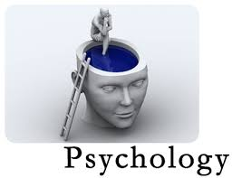
What is Psychology?

Slide 2
Psychology
Psychology is the science that studies behavior and the physiological and mental processes that underlie it, and it is the profession that applies the accumulated knowledge of this science to practical problems

Slide 3
Psychology
Psychology is the science that studies behavior and the physiological and mental processes that underlie it, and it is the profession that applies the accumulated knowledge of this science to practical problems

Slide 4
What is Science?
“Science is defined as a branch of knowledge or study dealing with a body of facts and truth systematically arranged.”

Slide 5
Scientific Theory?
A reasoned explanation tested by many observations and experiments
Tells why things are…

Slide 6
Three things
Must explain clearly and simply
Must be repeatable
Must be able to make predictions
Theories can be changed or modified by new evidence

Slide 7
Psychology is the science that studies behavior and the physiological and mental processes that underlie it, and it is the profession that applies the accumulated knowledge of this science to practical problems

Slide 8
Psychology is the science that studies behavior and the physiological and mental processes that underlie it, and it is the profession that applies the accumulated knowledge of this science to practical problems

Slide 9
Ted Talk
Ben Goldacre: Battling Bad Science

Slide 10
Lets brainstorm regarding what you all think a psychologist study?

Slide 11
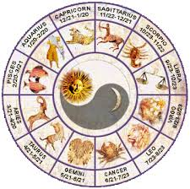
Go to the horoscope section of the newspaper and read your horoscope.
Observations?

Slide 12
The Barnum Effect
The tendency to believe general personality reports such as horoscopes. Named after P.T. Barnum, who once said a good circus should “have something for everyone.” Horoscopes work the same way.
https://www.youtube.com/watch?v=si2HoscBLIw
What do you think?
What is the basic way in which psychology differs from false sciences?
Why do you think false sciences are so widespread?

Slide 13
A Social Science vs. a False Science
Psychology is a social science based on verifiable evidence and theories that are tested according to the scientific method. False sciences, on the other hand, do not rely on verifiable evidence.

Slide 14
Scientific Theory
Describe
Explain
Predict
Control
Improve

Slide 15
Psychology
It is a scientific way of studying human behavior
It is a comprehensive discipline
It uses variety of methods to study a research question
It is pragmatic in approach: Intuitive or naive psychologist

Slide 16
Goals of Psychology
Describe: It describes what happens in an objective manner
Empirical in approach
Data driven
Operational definition

Slide 17
Explain: Provides explanation of an event
Predict
Control
Improve: Enhancing quality of life

Slide 18
Ben Ambridge : 10 myths about psychology, debunked
Ben Ambridge : 10 myths about psychology, debunked
How much of what you think about your brain is actually wrong? In this whistlestop tour of dis-proved science, Ben Ambridge walks through 10 popular ideas about psychology that have been proven wrong — and uncovers a few surprising truths about how our brains really work.
https://www.ted.com/talks/ben_ambridge_10_myths_about_psychology_debunked

